Slide 1
SILLM – Final Project
Comparing different prompting techniques on different topics
Claire Jordan, Sharon Bures, Elena Solar

Slide 2
Coding problems
Changing Jewels :
I have a red jewel of level N. (He has no other jewels). I can do either of the following operations any number of times.
Convert a red jewel of level n (n is at least 2) into "a red jewel of level (n-1) and X blue jewels of level n".
Or Convert a blue jewel of level n (n is at least 2) into "a red jewel of level (n-1) and Y blue jewels of level (n-1)".
I want as many blue jewels of level 1 as possible. At most, how many blue jewels of level 1 can he obtain by the operations?
Chocolate Problem:
I have decided to distribute chocolates to N friends on Valentine's Day. For the i-th friend (1≤i≤N), I want to give a square chocolate bar of size 2^A_i×2^A_i.
I have procured a rectangular chocolate bar of size H×W. It is partitioned by lines into a grid of H rows and W columns, each cell being a 1×1 square.
Determine whether it is possible to divide the chocolate bar along the lines into several pieces to obtain all the chocolate bars for my friends. It is fine to have leftover pieces.

Slide 3
Coding problems
Probably english
You are given N strings W_1,W_2,…,W_N consisting of lowercase English letters.
326-like number
A 326-like number is a three-digit positive integer where the product of the hundreds and tens digits equals the ones digit.
If one or more of these strings equal and, not, that, the, or you, then print Yes; otherwise, print No.
For example, 326,400,144 are 326-like numbers, while 623,777,429 are not.
Given an integer N, find the smallest 326-like number greater than or equal to N. It always exists under the constraints.
The Middle Day
In the calendar of MyteryLand, a year consists of M months: month 1, month 2, …, month M. The i-th month consists of D_i days: day 1, day 2, …, day D_i.
Furthermore, the number of days in a year is odd, that is, D_1+D_2+⋯+D_M is odd.
Find what day of what month is the middle day of the year.

Slide 4
Prompt Variations
Blurry
I am a student living on my own. I have 5 cats I need to take care of. I like flowers and rainbows. I listen to metal music and country songs. I think today I will eat pizza for dinner. Cooking is a lot of fun. I like to take basic recipes and make them special by preparing the food on my own. I also like to play the guitar and I am learning songs that I can play for my friends and family.
Emotional
I have to work on this problem for my job. I have to hand in the coding solution by the end of the day. I have nothing so far. My boss hinted heavily, that I would lose my job, if I don't hand in these results. I can't lose my job, I have to provide for my family, money is already tight, and I don't want to end up on the street with my 1 year old little boy, my precious little kid.
Chain of thought
Added explanation on how to solve each task
Expert persona
You are an expert in solving problems by using code. You have had years of experience working with webscraping, graphs and solving tricky problems using code.
Non-Expert persona
You are a physics student, that has not coded before, but you are currently taking a coding class and were given this problem, for which you are supposed to provide an answer code for the final project.

Slide 5
Models
Mistral
5 problems
3 runs
GPT 4
5 problems
3 runs
3 problems
3 runs
GPT 3.5
Overall
Default prompt: no switch of position
Blurry: instructions placed at the beginning, the middle and the end
Others: Instructions placed at the beginning and the end
468 results total

Slide 6
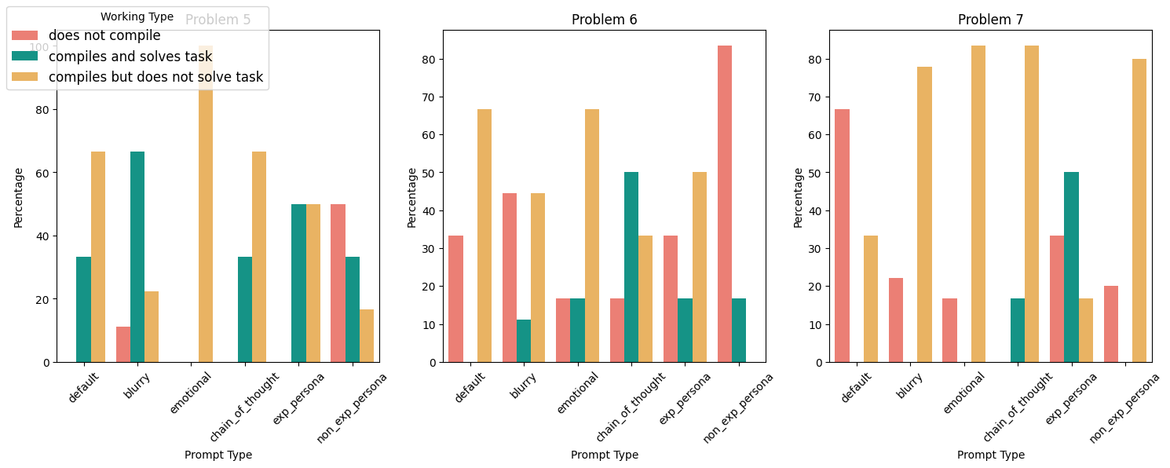

Mistral

Slide 7
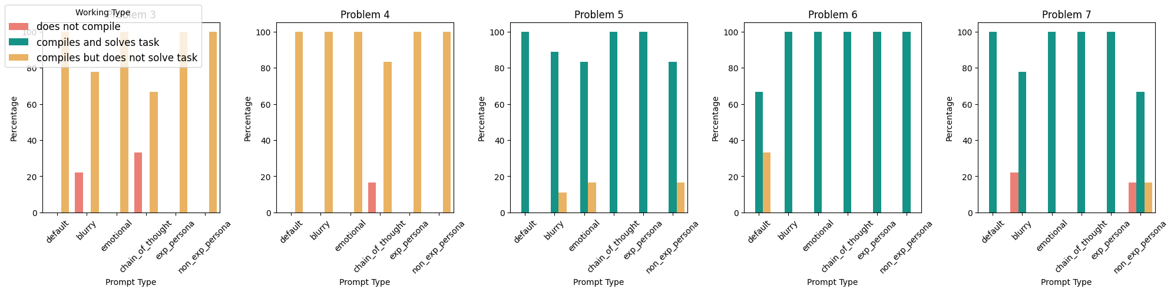
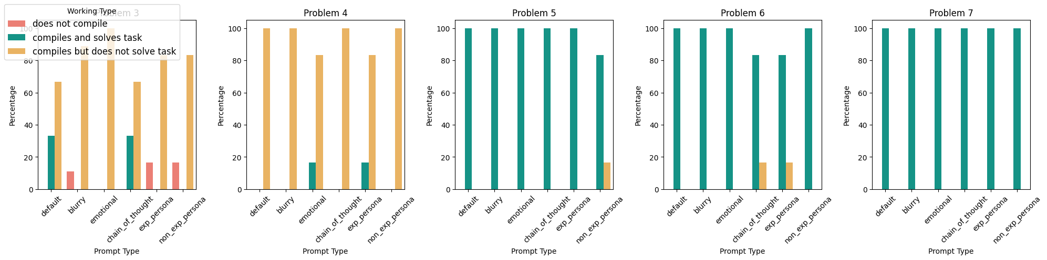
GPT 3.5 and GPT 4

Slide 8
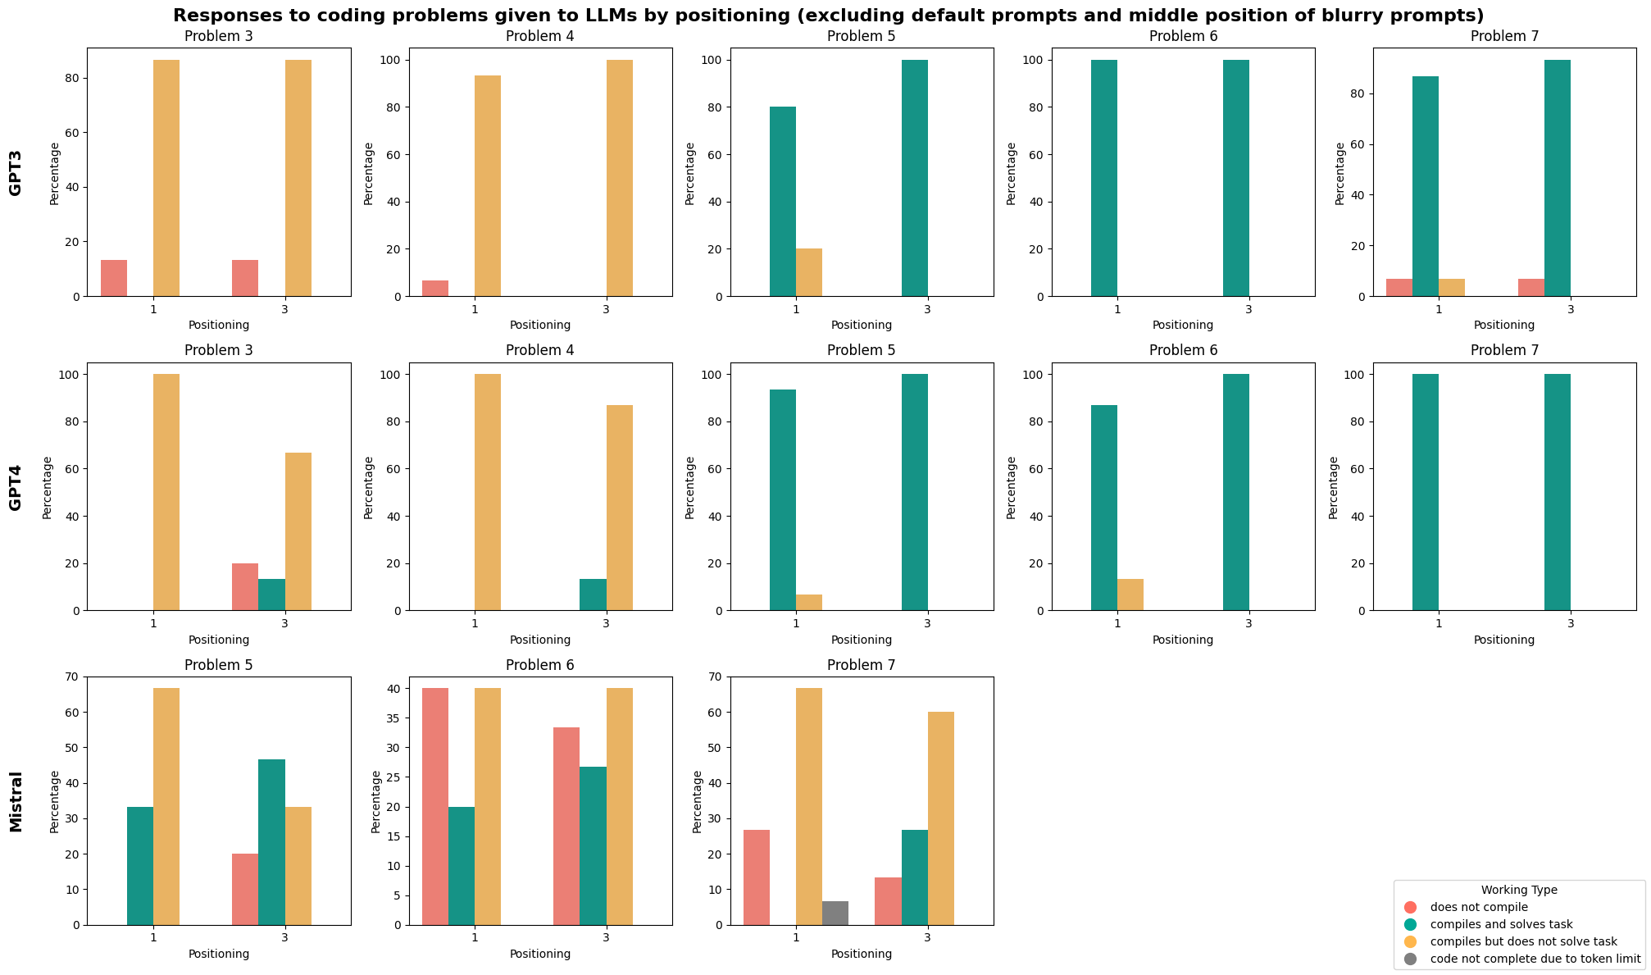
Effects of Position of Instructions

Slide 9
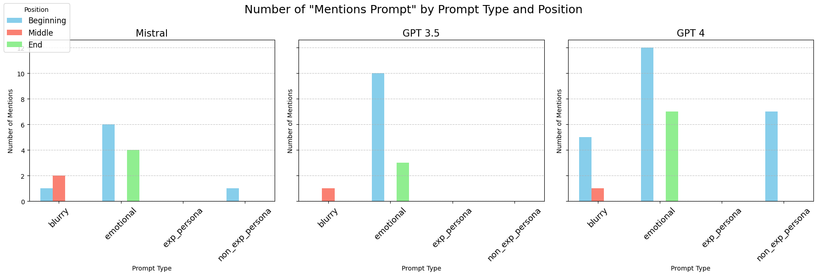
Models references to the prompts

Slide 10
Summary of Coding Part
No clear result of effectiveness of switching technique
Minimal effect of position
Further inspection of code needed
Choosing problems closer ot the LLMs coding limits

Slide 11
Thanks for your attention

